Slide 1
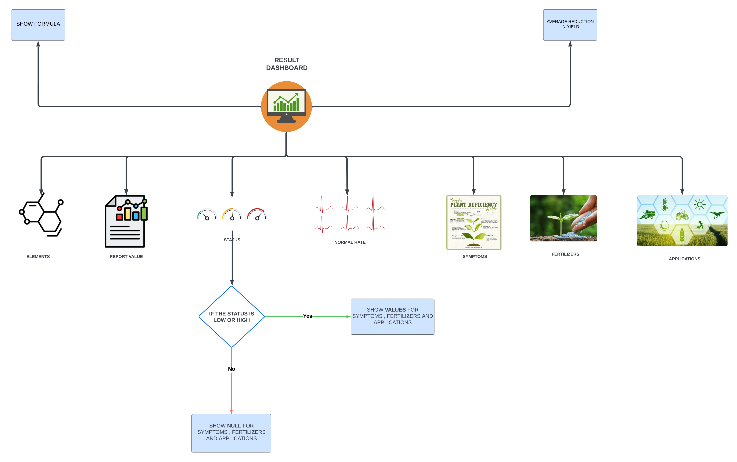

Slide 2
Result Dashboard:
The central hub where all analysis results are displayed. It provides a comprehensive view of soil nutrient status, recommendations, and expected yield reductions.
Elements:
Report Value: This component captures the actual measured values of various soil elements (e.g., nitrogen, phosphorus, potassium).
Status: It displays the status of each element, indicating whether it is within the optimal range, below the range, or above the range.
Normal Rate: Shows the normal or optimal range for each nutrient in the soil, helping to identify deficiencies or excesses.
Symptoms:
Based on the status of soil nutrients, this section identifies potential symptoms that the crops might exhibit due to nutrient imbalances.

Slide 3
Fertilizers:
Provides recommendations for specific fertilizers needed to address any deficiencies or excesses identified in the soil analysis.
Formula:
Show Formula: Displays the formula or calculation used to determine the nutrient status and recommendations.
This helps in understanding the basis of the recommendations and the expected impact on crop yields.
Average Reduction in Yield:
Calculates and displays the expected average reduction in crop yield based on the current soil nutrient status.
This information helps farmers understand the potential impact of nutrient deficiencies or excesses on their crop yield.
Decision Logic:
If the status of any nutrient is low or high, the module will show values for symptoms, fertilizers, and application methods needed to correct the imbalance.
If the status is within the normal range, the module will indicate that no action is needed for that particular nutrient.
Applications:
Specific Application Recommendations: Provides detailed guidelines on how to apply the recommended fertilizers. For example, "Apply 40-60 kg N/ha before planting or as a top dressing during active growth."
Timing and Method of Application: Suggests the best times and methods for fertilizer application to maximize nutrient uptake and crop yield.

